Slide 1
College
Majors and Minors
College Prep
Mr. Gordon
jgordon@bisdtx.org

Slide 2
Upcoming Events
Thurs. Sept. 16th Virtual 10th Grade Parent Meeting
Fri. Sept. 17th Student Council Elections
Tues. Sept. 21st Virtual 11th Grade Parent Meeting
Tues. Sept. 28th Spring Break 2023 Belize Travel Informational Meeting
hi

Slide 3

What are Majors and Minors?
Understanding what a college major and minor is, and the difference between the two is important as you begin your college career.
The University of Texas at Austin
hi

Slide 4

Majors and Minors
Major: the primary area of interest that you plan on getting a career in, required to graduate from college. The majority of your classes will be in this concentration. Examples include nursing, engineering, education, and business.
hi

Slide 5
Majors and Minors
Your major will be listed on your college diploma.
It will generally fall under two categories: Bachelor of the Arts
or Bachelor of Science
(we will discuss these in the next College Prep).
To fulfill your major, you will need to complete a list of required courses.
hi

Slide 6
Majors and Minors
Minor: the secondary area of interest that usually complements the major, but does not have to.
For example, if I wanted to be a Spanish teacher, I may major in education and minor in Spanish
or if I wanted to design video games, I may major in computer science and minor in art.
Minors can help you focus on what you would like to do as a career.
hi

Slide 7
Majors and Minors
Here is a list of all the majors that Texas Tech University in Lubbock offers: https://www.ttu.edu/majors-and-colleges/undergraduate-majors/
Scroll through and find three majors that interest you. If this link does not work, you can use this one for Texas State University
https://www.admissions.txstate.edu/explore/academics/majors-and-degrees.html.
hi

Slide 8
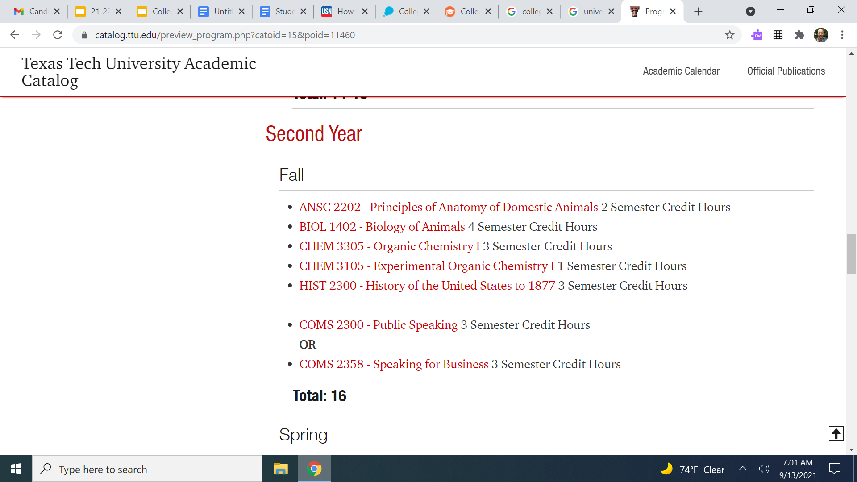
Majors and Minors
If you click on the major it will take you to the degree plan (required classes) for that major. Below is a screenshot of the Fall Semester of Sophomore year for Animal Science- Pre-Veterinary.
hi

Slide 9
Today’s College Prep Assignment
In the comments section of today’s College Prep,
list the three majors you are interested in and one class that is required in your third year for each of these majors.
hi

